Slide 1
Distracted Driver Training

Slide 2
Texting and driving is deadly
Distracted driving is any activity that diverts attention from driving including…
talking or texting on your phone,
eating and drinking,
talking to people in your vehicle,
fiddling with the stereo, entertainment or navigation system.
anything that takes your attention away from the task of safe driving.

Slide 3
Risk Takers - Video

Slide 4
Five Most Common Distractions While Driving
Cognitive distraction. anything that takes your mind off of the driving task
Cell phone use. ...
Events outside the vehicle. Billboards and Advertising. People and Pets. It's only natural to be drawn to people.
Drivers may carry on conversations or even have arguments with their passengers while driving. ...
Reaching for devices inside the vehicle.

Slide 5
Texting is the most alarming distraction. Sending or reading a text takes your eyes off the road for 3-5 seconds.
At 55 mph, that's like driving the length of an entire football field with your eyes closed.

Slide 6
One possible explanation that has been offered to explain this phenomenon is that drivers that text are 100 percent distracted from their driving duties for up to 4.6 seconds at a time.
During this time, drivers often decrease their following distance, which, when coupled with a slower reaction time to visual stimulus, such as brake lights, often results in catastrophe.

Slide 7
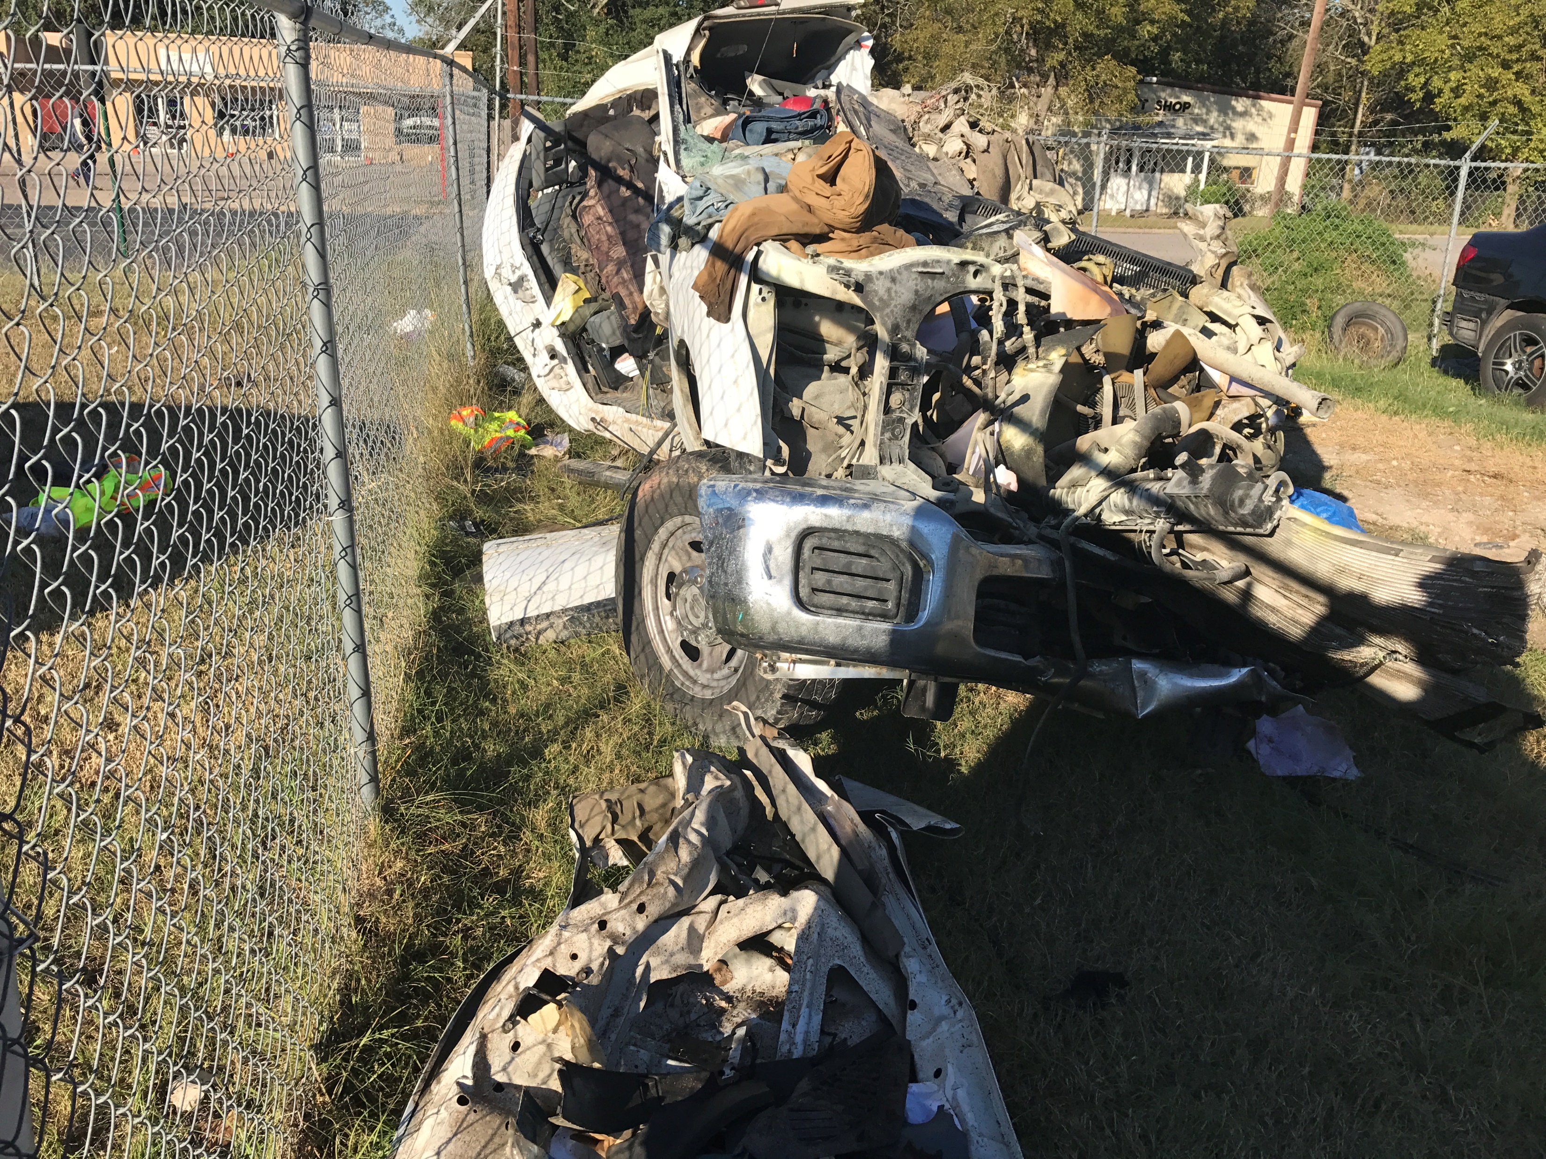
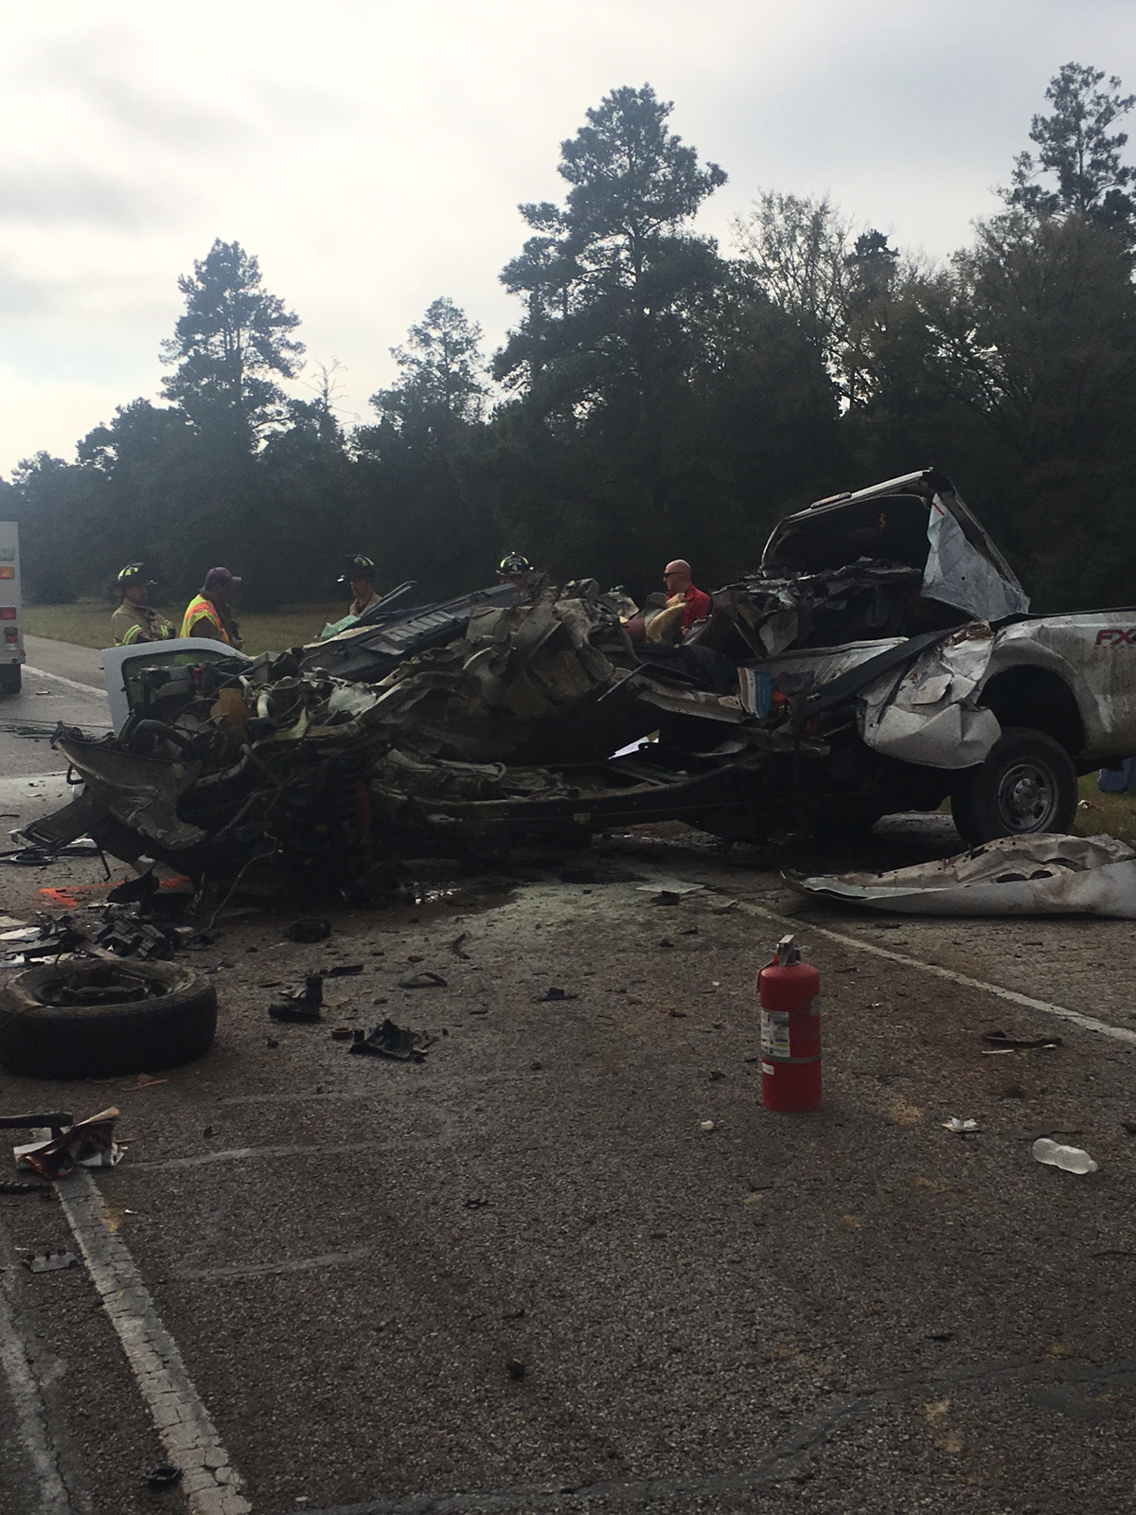

Slide 8
Distracted Driving
In 2017 there were 401 fatal crashes linked to cell phone use while driving
In 2018, over 2,800 people were killed and an estimated 400,000 were injured in crashes involving a distracted driver.
Distracted driving is dangerous, claiming 3,142 lives in 2019.
In 2020, nearly one in five crashes on Texas roads were caused by a distracted driver

Slide 9
The next time your cell phone beeps with a text message while you are driving to your destination, Think Twice before you pick up the phone to read a message or respond.

Slide 10
6 Apps That Help Prevent Texting While Driving
https://blog.americansafetycouncil.com/6-apps-that-help-prevent-texting-while-driving/
You keep hearing it, you may even see it, and now almost everyone in American with a smartphone knows that texting while driving is dangerous. But that doesn’t stop most of us from doing it, especially teenage drivers. In fact, an average of 9 Americans a day die in a crash caused by distracted driving, which includes texting. Now a days, 1 out of every 4 crashes involves cellphones, and cellphones increase the likelihood of a crash by 4x the normal amount. Despite these shocking numbers, many people reading this article will still glance at their phone while driving.

